Slide 1
Prestigio Solutions IDS RoadMap
Q1Y2023

Slide 2

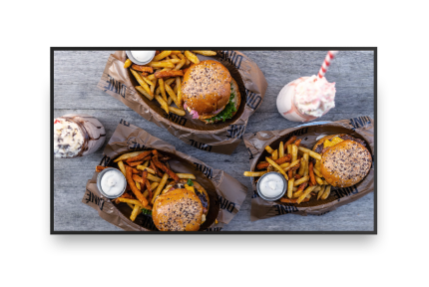

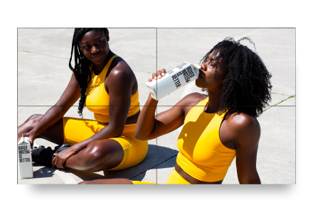
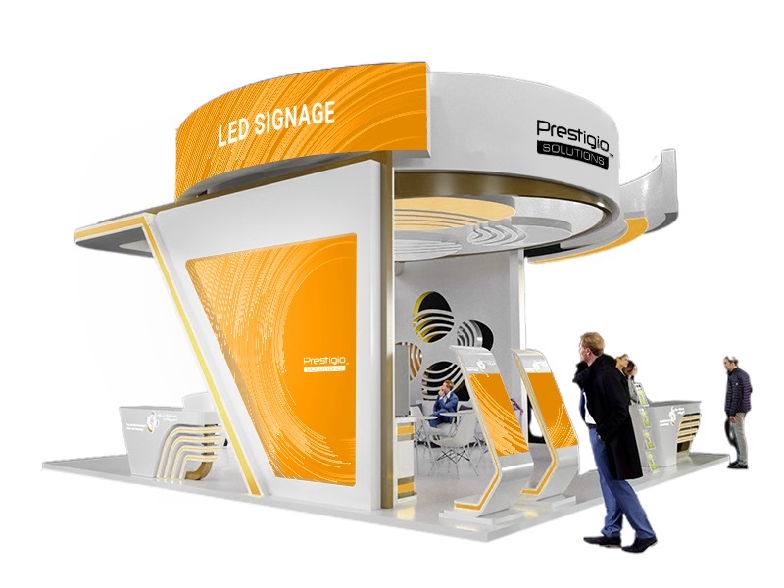

Digital Signage created for business
Discover ideal display solutions for any business
UHD Displays
The sharpest way to communicate
Video Walls
Immerse customer into visual
All-in-one indoor solutions (Totems)
LED Signage Outdoor&Indoor
Breath and eye will be taken
Bright content anywhere you need it
- create content, manage displays and analyze data with specialized software

Slide 3










Digital Signage is not the future but vital need of business
Uncover huge opportunities and bring second wind for your vertical market
Get the right attention for the right content
Omnichannel approach
Create and manage content for whole Digital Signage network
Always ON 24/7 every hour is working one never sleeps never eats
Reduce costs with centralized remote control on all devices
Manage staff costs, automate processes, faster, bigger better
Develop your own targeted advertising campaign and start it immediately
Gather valuable data, finally get to know what to do with them
See scalable real time analytics
Stand out in your way

Slide 4
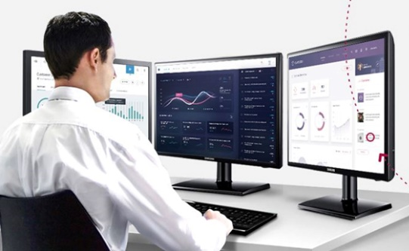











Discover the true power of your Prestigio Solutions Displays / Signage
Not just “another CMS”
Comprehensive Content Management
Advanced Data
Management
Industry grade device management
Create content with ease
Automation
Full remote hardware control
Schedule and public uninterrupted
Peer-to-Peer Data Transfer
Real time infrastructure monitoring
Integrate any type of content seamlessly
Leverage from campaign reports visualization
Be aware of any event any time any where

Slide 5
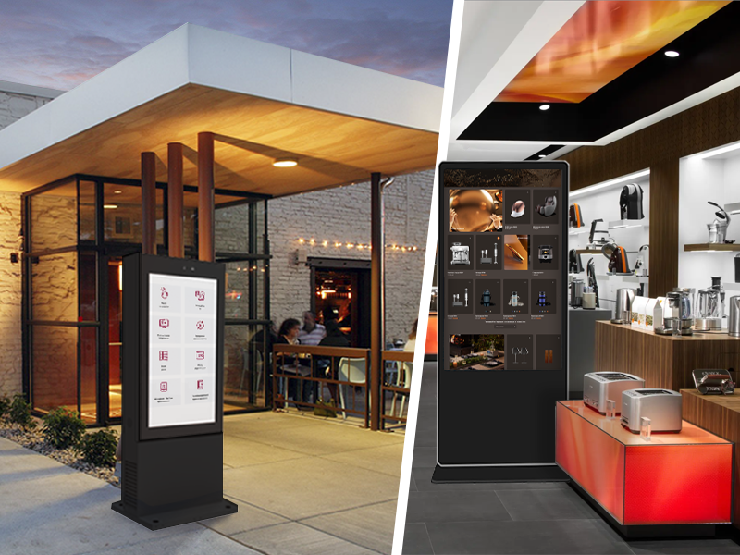


Digital Signage Totems
Be interactive anywhere you want or by business need
Powerful self-sufficient solution
Solid, strong, shatterproof

Slide 6

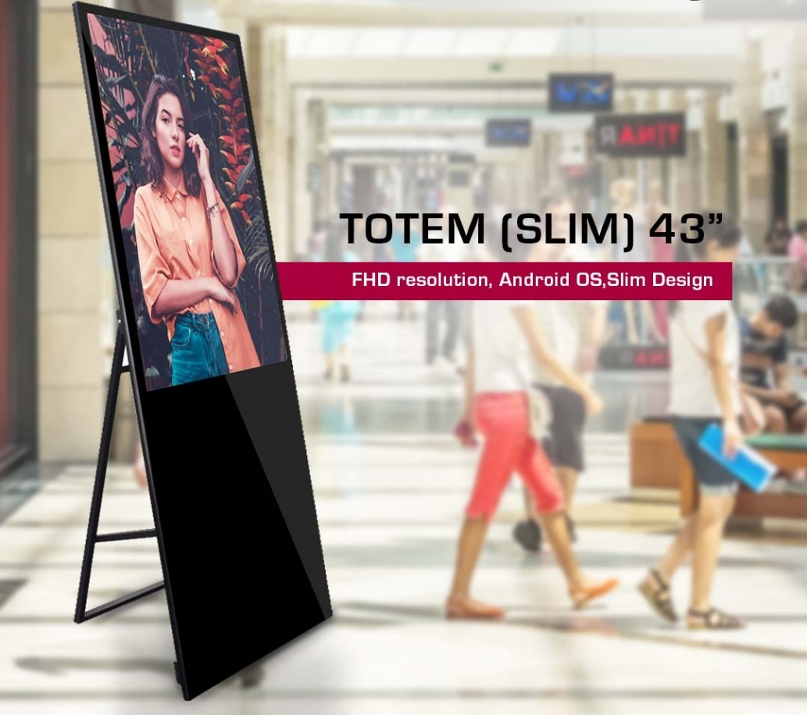
Prestigio Solutions™ Digital Signage Totem (slim) 43”
(PDSIM43SAN0P)*EOL
DIAGONAL SIZE, INCH / RATIO | 43" IPS / 16:9
RESOLUTION | 1080:1920 FHD
BRIGHTNESS | 275 nits
COLOUR | 16.7M
VISUAL ANGLE | H178°/V178°
RESPONSE TIME | 8 ms
CONTRAST RATIO | 1100:1
OPERATING CONDITIONS | 0℃ to 50℃ Storage -20℃ to 60℃
BUILD IN SPEAKERS | 5W * 2
MAX POWER CONSUMPTION | 180 W
POWER SUPPLY | 100V-240V,50-60 Hz
CPU | RK3288 ARM Cortex™ A17, 2.0GHZ
GPU | ARM Mali-T764 GPU
DDR | DDR3 2GB
ROM NAND FLASH | 8GB
WI FI SUPPORT | 802.11/b/g/n
OPERATING SYSTEM | OS Android
UNIT DEMENSION (W*D*H) | NET: 592.8*48*1750 mm GROSS: 860*200*1900 mm
WEIGHT | NET: 32 KG / GROSS: 63 KG
RDP / RRP | $1139 USD / $1399 USD w/o VAT

Slide 7

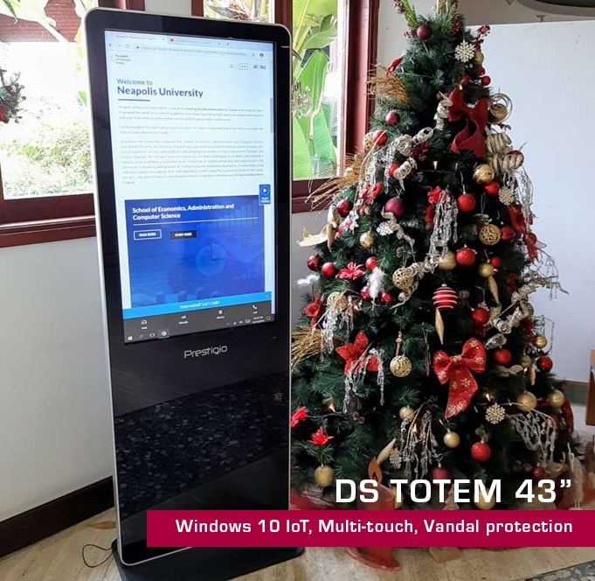

Prestigio Solutions™ Digital Signage Totem 43” (PDSIM43CWT6P)
*Most popular model
Tempered glass and vandal protection
With each unit goes perpetual Windows license and 1-year subscription on DisplayFroce
DIAGONAL SIZE, INCH / RATIO | 43” / 9:16 / IR: up to 10 points touch panel
RESOLUTION / R. FREQUENCY | 1080:1920 / 60Hz
BRIGHTNESS | 300 cd/m2
COLOUR | 16.7M
VIEWING ANGLE | H178°/V178°
RESPONSE TIME | 8 ms
CONTRAST RATIO | 3000:1
LIFETIME / OPERATING MODE | 30 000 h min / 16/7
WINDOWS PC | Intel Core i5 / DDR3 4GB / 128GB SSD / WiFi / Ethernet
WINDOWS OS | OS Windows 10 IoT
USB 2.0 / USB 3.0 / TF card / HDMI | 2 / 2(inside) / 1 / 1
WIFI / ETHERNET | 1/1
UNIT DIMENSION (HxWxD), MM | 1787*610*450 mm (with the stand)
PACKAGE DIMENSION (LXWXH), MM | 1900*280*850 mm
NET / GROSS, KG | 38 / 77
HOUSING MATERIAL/COLOR / GLASS | Metal + tempered glass, 4 mm
OPERATING CONDITIONS | 0℃ to 50℃ / 10% to 80%
BUILD IN SPEAKERS | 5W*2
MAX POWER CONSUMPTION | 75 W / Standby: <5W
ACCESSORY IN THE BOX | AC power cable, user guide, remote control, warranty card
POWER SUPPLY | 100V-240V,50-60 Hz
RDP / RRP | $1669 USD / $1999USD w/o VAT
Production time: 2.5 months
Delivery time: train - 3 weeks / SEA – 6 weeks
MOQ: 50 pcs

Slide 8
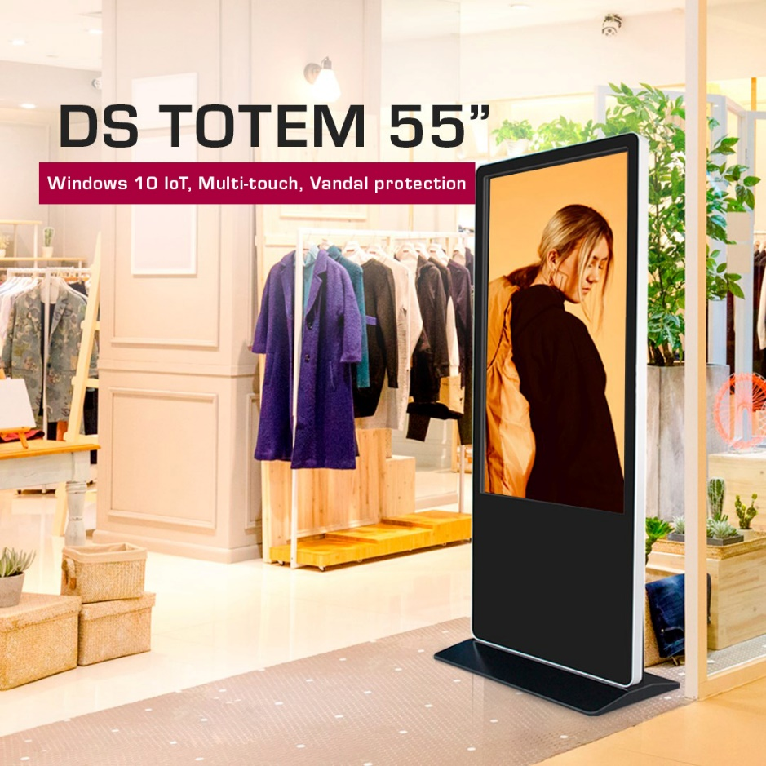
Prestigio Solutions™ Digital Signage Totem 55” (PDSIM55SWT6P)
*Most popular model
Tempered glass and vandal protection
With each unit goes perpetual Windows license and 1-year subscription on DisplayFroce
DIAGONAL SIZE, INCH / RATIO | IPS 54.64” (55”) / 16:9 / IR: up to 10 points touch panel
RESOLUTION / R. FREQUENCY | 1080:1920 / 60Hz
BRIGHTNESS | 300 cd/m2
COLOUR | 16.7M
VIEWING ANGLE | H178°/V178°
RESPONSE TIME | 8 ms
CONTRAST RATIO | 1200:1
LIFETIME / OPERATING MODE | 50 000 h / 16/7
WINDOWS PC | Intel®Core™ i5 / DDR3 4GB / SSD 128GB / WIFI / Gigabit Ethernet / OS Windows 10 IoT
DECODING RES | 1080p max
USB 2.0 / USB 3.0 | 2/2 (inside)
HDMI OUT / VGA OUT / Audio IN | 1/1/1
WIFI / ETHERNET | 1/1
UNIT DIMENSION (LXWXH), MM | 791x450x1850mm (with base)
PACKAGE DIMENSION (LXWXH), MM | 1050x240x2000mm
NET / GROSS, KG | App. Tbc - 62 / 108 kg (wooden box)
HOUSING MATERIAL/COLOR / GLASS | Metal + tempered glass, 5 mm
OPERATING CONDITIONS | 0℃ to 50℃ / 10% to 80%
BUILD IN SPEAKERS | 5W*2
POWER CONSUMPTION | 180W / Standby: <5W
ACCESSORY IN THE BOX | AC power cable, user guide, remote control, warranty card
POWER SUPPLY | 100V-240V,50-60 Hz
RDP / RRP | $2249 USD / $2769 USD w/o VAT
Production time: 2.5 months
Delivery time: train - 3 weeks / SEA – 6 weeks
MOQ: 50 pcs

Slide 9

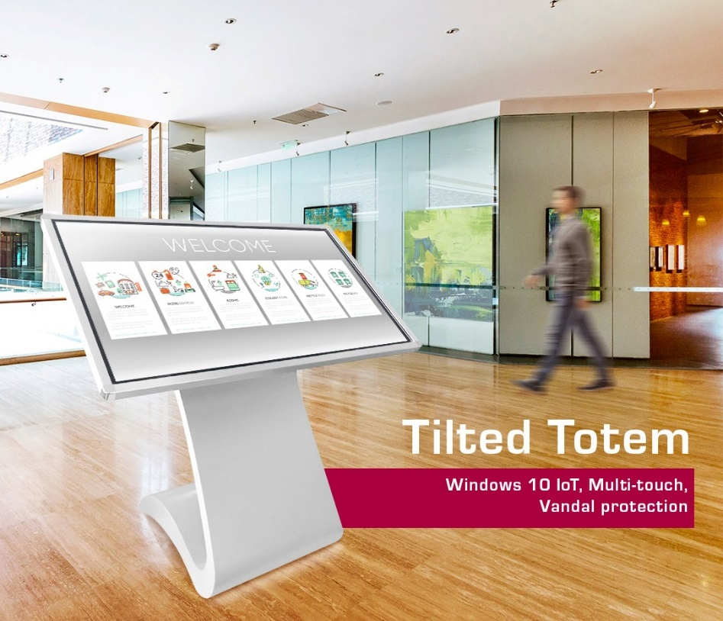
Prestigio Solutions™ Digital Signage Tilted Totem 43” (PDSIM43SWT6P) *Most popular model
Tempered glass and vandal protection
Stand alone option (works without Internet)
Rebrandable housing and software
With each unit goes perpetual Windows license and 1-year subscription on DisplayFroce
DIAGONAL SIZE, INCH / RATIO | 43” / 16:9
RESOLUTION / R. FREQUENCY | 1920:1080 / 60Hz
BRIGHTNESS | 300 cd/m2
COLOUR | 16.7M
VIEWING ANGLE | H178°/V178°
RESPONSE TIME | 8 ms
CONTRAST RATIO | 1200:1
LIFETIME / OPERATING MODE | 50 000 h min / 16/7
PC onboard | Intel Core i5 / DDR3 8GB / 128GB SSD
OS | Windows 10 IoT
TOUCH FUNCTION | IR/up to 10 point
BUILD IN SPEAKERS | 5W*2
USB | USB 2.0 x 1 / USB 3.0 x 1 (internal)
WIFI / RJ45 / VGA / HDMI | 802.11 (b,g,n) / LAN x 1 / VGA x 1 / HDMI x 1
UNIT DIMENSION (W*D*H), MM | Screen body: 1015*603.5*76mm / Base stand: 988.47*510*600.94 mm
PACKAGE DIMENSION (W*D*H), MM | 1150*850*850 mm
NET / GROSS, KG | 43 / 90
HOUSING MATERIAL/COLOR / GLASS | White metal + 3mm tempered glass
OPERATING CONDITIONS | 0℃ to 50℃ / 10% to 90%
POWER CONSUMPTION | 75 W
ACCESSORY IN THE BOX | AC power cable, user guide, warranty card
POWER SUPPLY | 100V-240V,50-60 Hz
RDP / RRP | $1749 USD / $2149 w/o VAT
Production time: 2.5 month
Delivery time: train - 3 weeks / SEA – 6 weeks
MOQ: 50 pcs

Slide 10
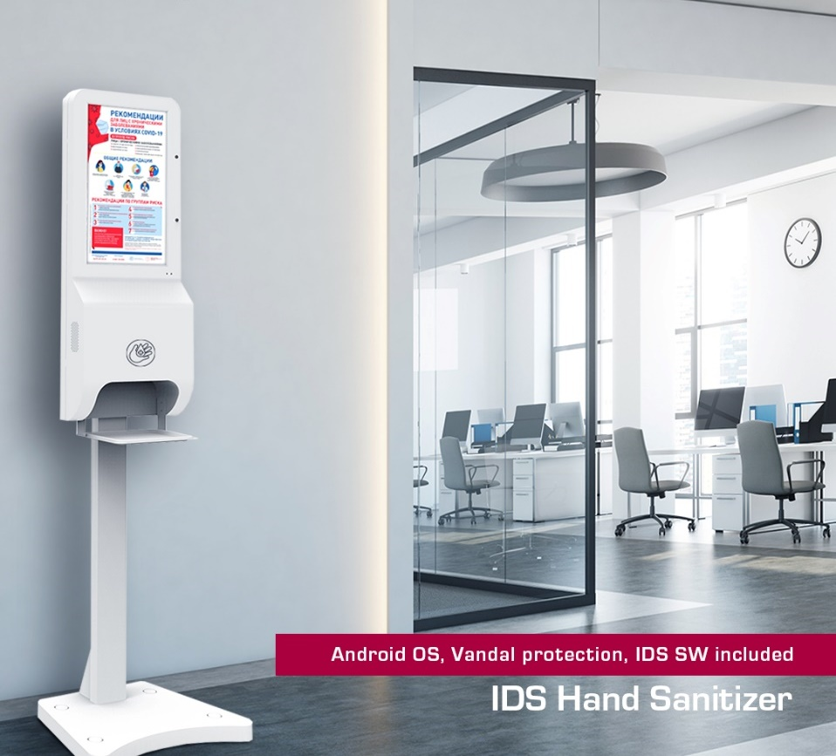
Prestigio Solutions™ Digital Signage Hand Sanitizer 21.5”
Wall Mount (stand included) PDSIM21CAN0P
*EOL
Vandal protection (metal case & 3mm tempered glass)
Integrated camera for targeting & content reaction
3L Auto hands dispenser
Remote administration, control and analysis (IDS SW)
Temperature sensor detection (50cm distance)
Switch ON/Off by schedule; End of liquid detection…
DIAGONAL SIZE, INCH / RATIO | 21.5” (3mm Tempered glass)
RESOLUTION | 1080:1920 FHD
BRIGHTNESS | 200 nit
COLOUR | 16.7M
Visual ANGLE | H178°/V178°
INTEGRATED PC | Android 7.1
CPU | Quad Core Cortex A 17
GPU | ARM Mali-T764
RAM | 4GB
ROM | 16GB
BUILD IN SPEAKERS | 2 x 5W
POWER CONSUPTION | 50W / standby 3W
POWER SUPPLY | AC100 – 240V 50/60Hz
ADDITIONALLY | 2MP front camera; WiFi (b,g,n); IDS SW 1Y FREE USAGE
PORTS | USB 2.0 x 2; LAN
UNIT DIMENSION (W*D*H), MM | 524 x 413 x 1900 mm
PACKAGE DIMENSION (W*D*H), MM | 1625 x 250 x 550 mm
NET / GROSS, KG | 27/ 35
RDP / RRP (with stand) | $699 USD / $899 USD w/o VAT
LAST STOCK UNITS

Slide 11
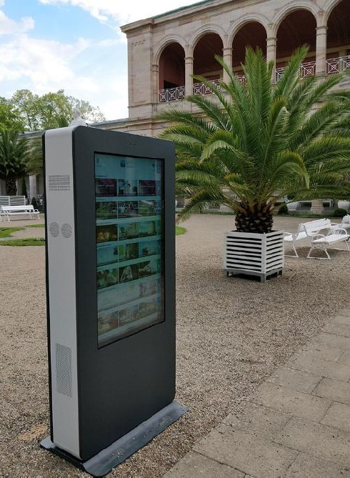
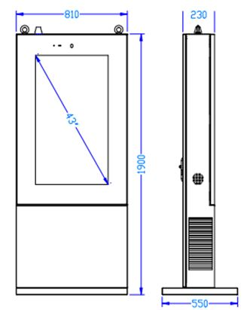
Prestigio Solutions™ Digital Signage Totem OutDoor 43” (PDSOM43SWN0P)
DIAGONAL SIZE, INCH / RATIO | 43" IPS / 9:16
RESOLUTION | 1080:1920 FHD
BRIGHTNESS | 1500 nits
COLOUR | 16.7M
Visual ANGLE | H178°/V178°
RESPONSE TIME | 8 ms
CONTRAST RATIO | 1200:1
OPERATING CONDITIONS | -30℃ to 50℃ Storage -30℃ to 60℃
PROTECTION | IP65
BUILD IN SPEAKERS | 5W * 2
MAX POWER CONSUMPTION | 1000W (with heater) / Standby: 200W
POWER SUPPLY (Industrial) | 100V-240V,50-60 Hz
WORKING HOURS | 24/7
PC WINDOWS | Intel® Core™ i5 (1.7GHz)
GPU | Intel® HD Graphics 4000
DDR | DDR3 4GB
ROM | 128GB SSD
WI FI SUPPORT | 802.11/b/g/n
OPERATING SYSTEM | OS Windows 10 IoT
UNIT DEMENSION (W*D*H) | 1900 x 810 x 230 mm Base Stand 810 x 550 x 50 mm
WEIGHT | TBC
RDP / RRP | $3399 USD / $4099 USD w/o VAT
Production time: 2.5 months
Delivery time: train - 3 weeks / SEA – 6 weeks
MOQ: 10 pcs
*TP 20 Touch could be added optionally
* Camera could be added optionally

Slide 12
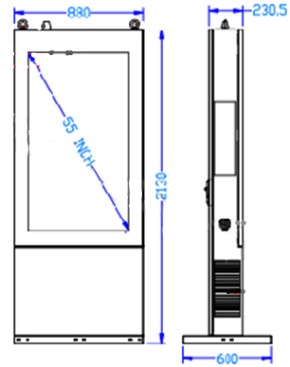
Prestigio Solutions™ Digital Signage Totem OutDoor 55” (PDSOM55SWN0P)
DIAGONAL SIZE, INCH / RATIO | 55" IPS / 9:16 with 5mm Tempered Glass
RESOLUTION | 1080:1920 FHD
BRIGHTNESS | 1500 nits
COLOUR | 16.7M
Visual ANGLE | H178°/V178°
RESPONSE TIME | 8 ms
CONTRAST RATIO | 1000:1
OPERATING CONDITIONS | -30℃ to 50℃ Storage -30℃ to 60℃
PROTECTION | IP65
BUILD IN SPEAKERS | 5W * 2
MAX POWER CONSUMPTION | 1000W (with heater) / Standby: 200W
POWER SUPPLY (Industrial) | 100V-240V,50-60 Hz
WORKING HOURS | 24/7
PC WINDOWS | Intel® Core™ i5 (1.7GHz) 3317U
GPU | Intel® HD Graphics 4000
DDR | DDR3 4GB
ROM | 128GB SSD
WI FI SUPPORT | 802.11/b/g/n
OPERATING SYSTEM | OS Windows 10 IoT
UNIT DEMENSION (W*D*H) | 2080x880x230 mm Base Stand 880 x 600 x 50 mm
WEIGHT | 172 Kg approx Base Stand 18 Kg
RDP / RRP | $4499 USD / $5399 USD w/o VAT
Production time: 2.5 months
Delivery time: train - 3 weeks / SEA – 6 weeks
MOQ: 10 pcs
*TP 20 IR Touch could be added optionally
* Camera could be added optionally

Slide 13

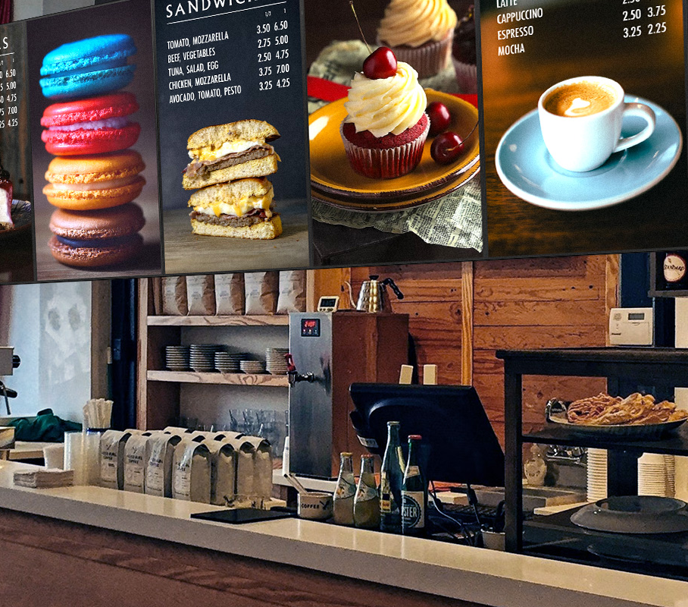

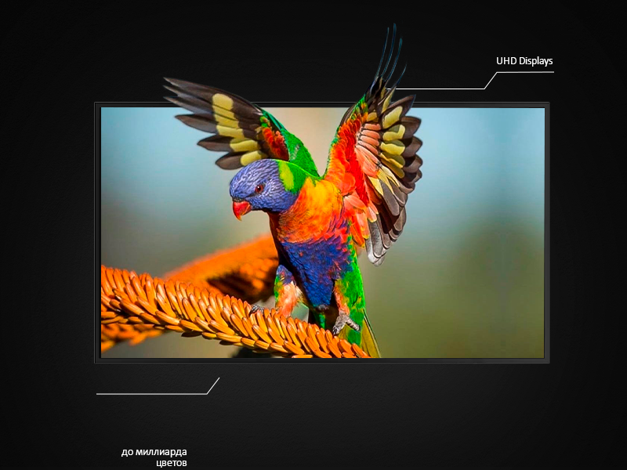
Wall mount (UHD displays)
Be in line with 4K content Era
Create solution your customer really needed
More then 1 billion colors

Slide 14
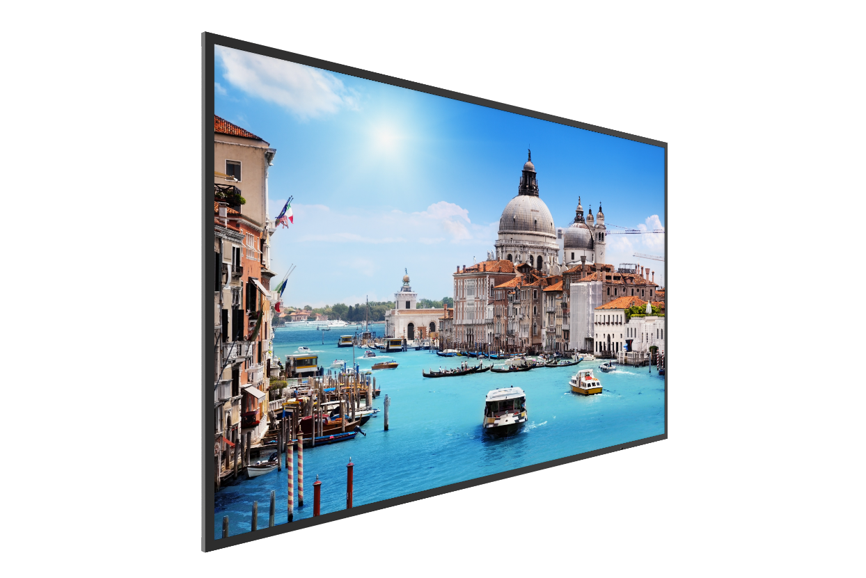
Prestigio Solutions™ Digital Signage Wall Mount 43” (PDSIK43WNN0L)
DIAGONAL SIZE, INCH / RATIO | 42.51” (43”) D-LED
RESOLUTION / R. FREQUENCY | 3840 x 2160 Landscape usage only / 60Hz
BRIGHTNESS | 350 cd/m2
COLOUR | 1.07B (10 bit)
VIEWING ANGLE | H178°/V178°
RESPONSE TIME | 6 ms
CONTRAST RATIO | 1100:1
LIFETIME / OPERATING MODE | 30 000 h min / 18/7
USB 2.0 | 1
HDMI CEC IN / VGA IN / Audio (IN/OUT) | 1/1/1
RS232 IN / RS232 OUT | 1/1 RJ45
UNIT DIMENSION (WXDXH), MM | 970x84.8x558.3 mm / Bezel: 13 mm
PACKAGE DIMENSION (WXDXH), MM | 1070x153x663 mm
NET / GROSS, KG | 9 kg / 12.2 kg
HOUSING MATERIAL/COLOR | Metal / Black
OPERATING CONDITIONS | 0℃ to 40℃ / 20% to 85%
BUILD IN SPEAKERS | 5W*2
POWER CONSUMPTION | 85W / In standby: <0.5W
VESA | VESA size (400mm x 200mm)
ACCESSORY IN THE BOX | AC power cable, user guide, remote control, warranty card, Wall Mounting kit
POWER SUPPLY | 100V-240V, 50-60 Hz
RDP / RRP | $499 USD / $619 USD w/o VAT
Slim design
Metal case
Competitive price
Production time: 2.5 months
Delivery time: train - 3 weeks / SEA – 6 weeks
MOQ: 50 pcs from all Offices

Slide 15
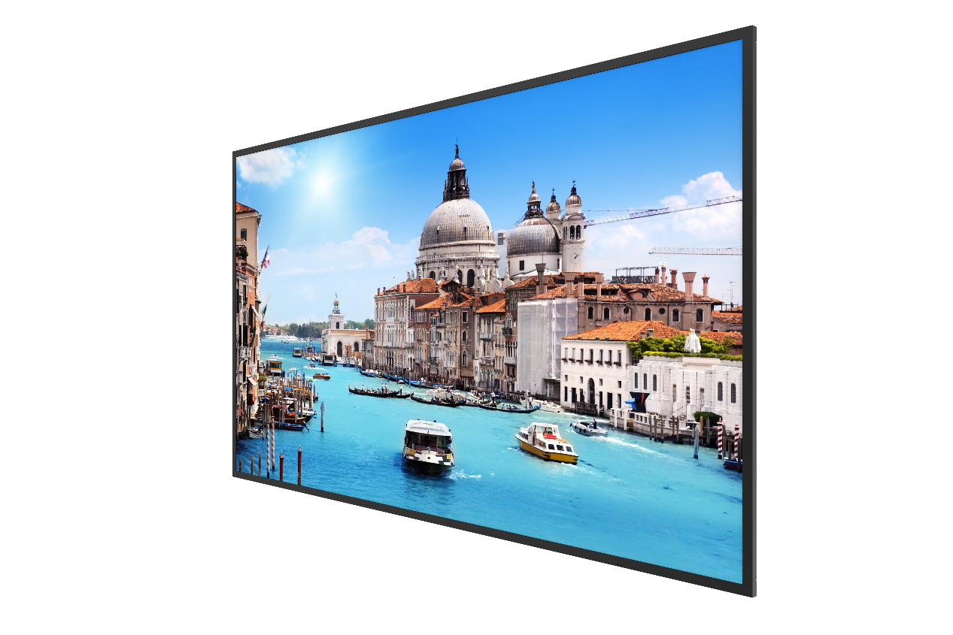
Prestigio Solutions™ Digital Signage Wall Mount 55” (PDSIK55WNN0L)
*Most popular model
DIAGONAL SIZE, INCH / RATIO | 54.64” (55”) D-LED
RESOLUTION / R. FREQUENCY | 3840 x 2160 Landscape usage only / 60Hz
BRIGHTNESS | 350 cd/m2
COLOUR | 1.07B (10 bit)
VIEWING ANGLE | H178°/V178°
RESPONSE TIME | 6 ms
CONTRAST RATIO | 1200:1
LIFETIME / OPERATING MODE | 30 000 h min / 18/7
USB 2.0 | 1
HDMI CEC IN / VGA IN / Audio (IN/OUT) | 1/1/1
RS232 IN / RS232 OUT | 1/1 RJ45
UNIT DIMENSION (WXDXH), MM | 1243x70x714 mm / Bezel: 13.9 mm
PACKAGE DIMENSION (WXDXH), MM | 1364x154x824 mm
NET / GROSS, KG | 15 kg / 18.6 kg
HOUSING MATERIAL/COLOR | Metal / Black
OPERATING CONDITIONS | 0℃ to 40℃ / 20% to 85%
BUILD IN SPEAKERS | 5W*2
POWER CONSUMPTION | 140W / In standby: <0.5W
VESA | VESA size (400mm x 400mm)
ACCESSORY IN THE BOX | AC power cable, user guide, remote control, warranty card, Wall Mounting kit
POWER SUPPLY | 100V-240V, 50-60 Hz
RDP / RRP | $559 USD / $699 USD w/o VAT
Slim design
Metal case
Competitive price
Production time: 2.5 months
Delivery time: train - 3 weeks / SEA – 6 weeks
MOQ: 50 pcs from all Offices

Slide 16
Prestigio Solutions™ Digital Signage Wall Mount PRO 55” (PDSIK55WNN0U) *EOL
DIAGONAL SIZE, INCH / RATIO | 54.64” (55”) D-LED
RESOLUTION / R. FREQUENCY | 1920 x 1080 Landscape & Portrait usage / 60Hz
BRIGHTNESS | 350 cd/m2
COLOUR | 1.07B (8 bit)
VIEWING ANGLE | H178°/V178°
RESPONSE TIME | 6 ms
CONTRAST RATIO | 1000:1
LIFETIME / OPERATING MODE | 30 000 h min / 24/7
USB 2.0 | 1
HDMI CEC IN / VGA IN / Audio (IN/OUT) | 1/1/1
RS232 IN / RS232 OUT | 1/1 RJ45
UNIT DIMENSION (WXDXH), MM | 1243x70x714 mm / Bezel: 13.9 mm
PACKAGE DIMENSION (WXDXH), MM | 1364x154x824 mm
NET / GROSS, KG | 15 kg / 18.6 kg
HOUSING MATERIAL/COLOR | Metal / Black
OPERATING CONDITIONS | 0℃ to 40℃ / 20% to 85%
BUILD IN SPEAKERS | 5W*2
POWER CONSUMPTION | 140W / In standby: <0.5W
VESA | VESA size (400mm x 400mm)
ACCESSORY IN THE BOX | AC power cable, user guide, remote control, warranty card, Wall Mounting kit
POWER SUPPLY | 100V-240V, 50-60 Hz
RDP / RRP | $529 USD / $639 USD w/o VAT
Slim design
Metal case
Competitive price
Professional Panel 24/7

Slide 17

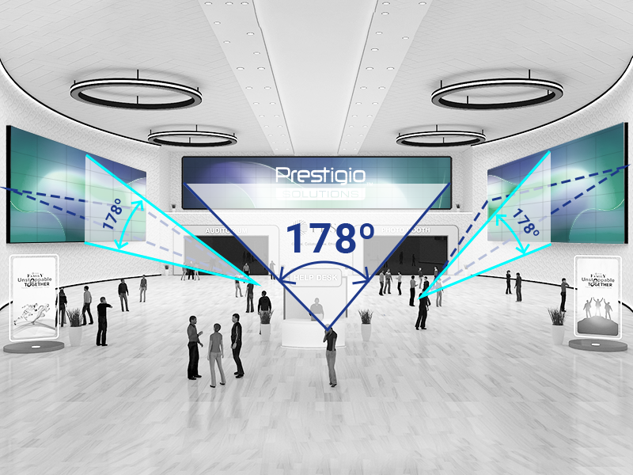

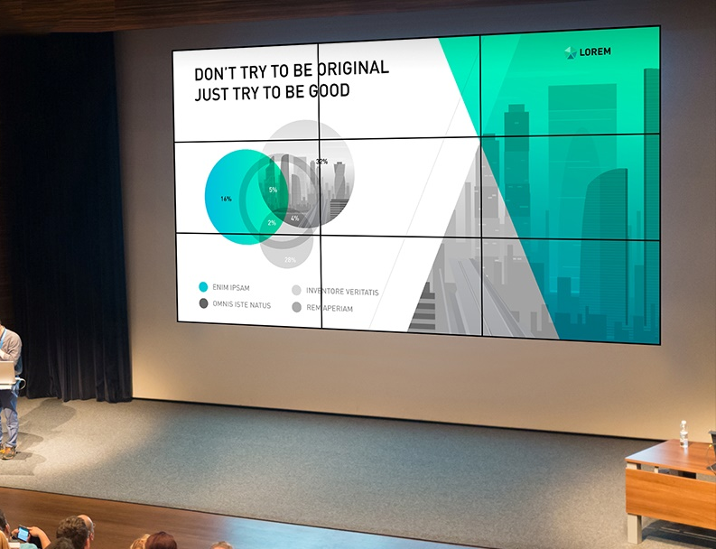

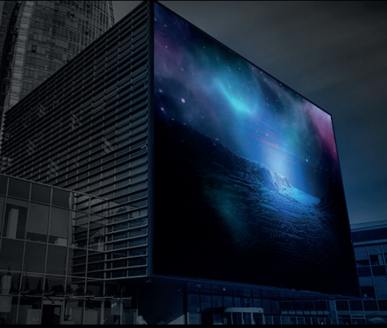
LCD Video Walls
Seamless large screens with super slim bezel
View content form any angle
Any wall could be a Video Wall

Slide 18
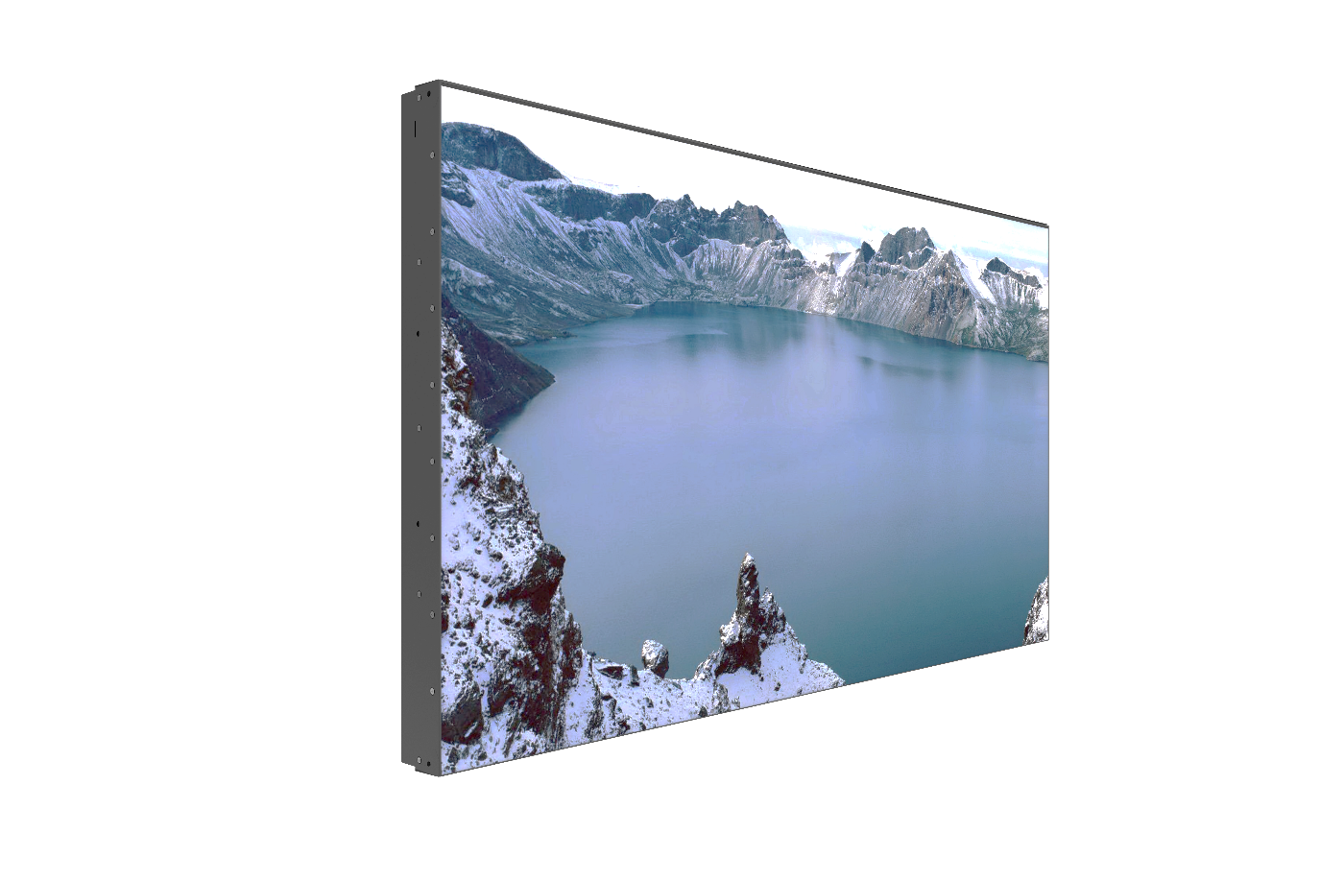
Prestigio Solutions™ Digital Signage Video Wall 49”, 3.5mm bezel (PDSIN49WNN0L)
DIAGONAL SIZE, INCH / RATIO | 48.5” (49”) D-LED
RESOLUTION / R. FREQUENCY | 1920 x 1080 Landscape & Portrait usage / 60Hz
BRIGHTNESS | 450 cd/m2
COLOUR | 1.07B (10 bit)
VIEWING ANGLE | H178°/V178°
RESPONSE TIME | 8 ms
CONTRAST RATIO | 1300:1
LIFETIME / OPERATING MODE | 50 000 h min / 24/7
USB 2.0 | 1
HDMI IN / VGA IN / DP IN / DVI IN & OUT | 2/1/1/1&1
RS232 IN / RS232 OUT | 1/1 RJ45
UNIT DIMENSION (WXDXH), MM | 1077.58x113.65x607.8 mm / Dual Bezel: 3.5 mm
PACKAGE DIMENSION (WXDXH), MM | 1245x218x783 mm (1 pcs in one box)
NET / GROSS, KG | TBD 28 kg / 31.5 kg (1 pcs in one box)
HOUSING MATERIAL/COLOR | Metal / Black
OPERATING CONDITIONS | 0℃ to 40℃ / 20% to 85%
POWER CONSUMPTION | 100W / In standby: <0.5W
ACCESSORY IN THE BOX | Power cable, user guide, HDMI cable, warranty card. VESA option on the LCD (600mm x 400mm), VESA kit is NOT included
POWER SUPPLY | 100V-240V, 50-60 Hz
RDP / RRP | $999 USD / $1269 USD w/o VAT
Slim 3.5mm bezel (dual)
Competitive price
Production time: 2.5 months
Delivery time: train - 3 weeks / SEA – 6 weeks
MOQ: 50 pcs from all Offices

Slide 19
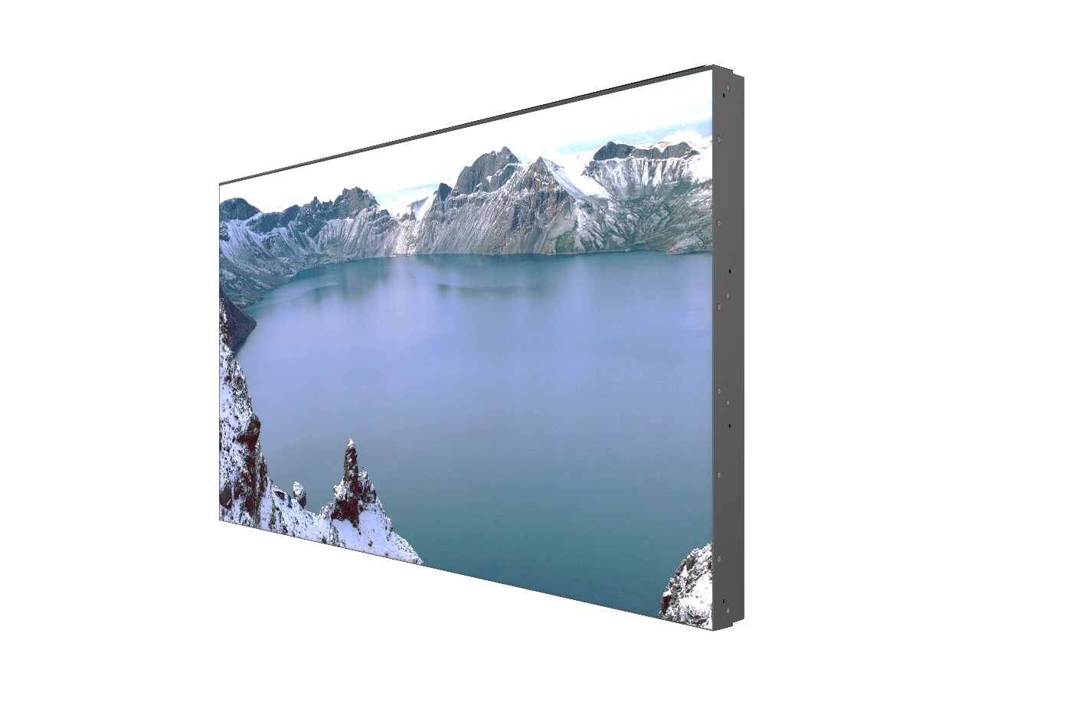
Prestigio Solutions™ Digital Signage Video Wall 55”, 3.5mm bezel (PSIW55N0U0)
DIAGONAL SIZE, INCH / RATIO | 54.64” (55”) D-LED
RESOLUTION / R. FREQUENCY | 1920 x 1080 Landscape & Portrait usage / 60Hz
BRIGHTNESS | 500 cd/m2
COLOUR | 1.07B (10 bit)
VIEWING ANGLE | H178°/V178°
RESPONSE TIME | 8 ms
CONTRAST RATIO | 1200:1
LIFETIME / OPERATING MODE | 50 000 h min / 24/7
USB 2.0 | 1
DP OUT, DP IN, HDMI IN, USB 2.0 | 1/2/2/1
RS232 IN / RS232 OUT, LAN | 1/1 RJ45, 1
UNIT DIMENSION (WXDXH), MM | 1213.4x121.85x684.2 mm / Dual Bezel: 3.5 mm
PACKAGE DIMENSION (WXDXH), MM | 1385x348x858 mm (2 pcs in one box)
NET / GROSS, KG | 28 kg / 31.5 kg (1 pcs in one box)
HOUSING MATERIAL/COLOR | Metal / Black
OPERATING CONDITIONS | 0℃ to 40℃ / 20% to 85%
POWER CONSUMPTION | 200W / In standby: <0.5W
ACCESSORY IN THE BOX | Power cable, user guide, Remote control, HDMI cable, warranty card. VESA option on the LCD (600mm x 400mm), VESA kit is NOT included
POWER SUPPLY | 100V-240V, 50-60 Hz
RDP / RRP | $739 USD / $919 USD w/o VAT
Production time: 2.5 months
Delivery time: train - 3 weeks / SEA – 6 weeks
MOQ: 50 pcs from all Offices

Slide 20
Prestigio Solutions™ Digital Signage Video Wall 55”, 0.88mm bezel (PDSIS55WNN0M)
DIAGONAL SIZE, INCH / RATIO | 54.64” (55”) D-LED
RESOLUTION / R. FREQUENCY | 1920 x 1080 Landscape & Portrait usage / 60Hz
BRIGHTNESS | 700 cd/m2
COLOUR | 1.07B (10 bit)
VIEWING ANGLE | H178°/V178°
RESPONSE TIME | 8 ms
CONTRAST RATIO | 1200:1
LIFETIME / OPERATING MODE | 50 000 h min / 24/7
USB 2.0 | 1
HDMI IN / VGA IN / DP IN / DVI IN & OUT | 2/1/1/1&1
RS232 IN / RS232 OUT | 1/1 RJ45
UNIT DIMENSION (WXDXH), MM | 1210.5x121.1x681.2 mm / Dual Bezel: 0.88 mm
PACKAGE DIMENSION (WXDXH), MM | TBD 1380x213x850 mm (1 pcs in one box)
NET / GROSS, KG | TBD 28 kg / 31.5 kg (1 pcs in one box)
HOUSING MATERIAL/COLOR | Metal / Black
OPERATING CONDITIONS | 0℃ to 40℃ / 20% to 85%
POWER CONSUMPTION | 225W / In standby: <0.5W
ACCESSORY IN THE BOX | Power cable, user guide, HDMI cable, warranty card. VESA option on the LCD (600mm x 400mm), VESA kit is NOT included
POWER SUPPLY | 100V-240V, 50-60 Hz
RDP / RRP | $2319 USD / $2859 USD w/o VAT
Slim 0.88 mm bezel (dual) only
Competitive price
Production time: 2.5 months
Delivery time: train - 3 weeks / SEA – 6 weeks
MOQ: 50 pcs from all Offices

Slide 21
Prestigio Solutions™ Digital Signage Video Wall 55”, 1.8mm bezel (PDSIL55WNN0L)
DIAGONAL SIZE, INCH / RATIO | 54.64” (55”) D-LED
RESOLUTION / R. FREQUENCY | 1920 x 1080 Landscape & Portrait usage / 60Hz
BRIGHTNESS | 500 cd/m2
COLOUR | 1.07B (10 bit)
VIEWING ANGLE | H178°/V178°
RESPONSE TIME | 8 ms
CONTRAST RATIO | 1400:1
LIFETIME / OPERATING MODE | 50 000 h min / 24/7
USB 2.0 | 1
HDMI IN / VGA IN / DP IN / DVI IN & OUT | 2/1/1/1&1
RS232 IN / RS232 OUT | 1/1 RJ45
UNIT DIMENSION (WXDXH), MM | 1211.4x121.1x682.2 mm / Dual Bezel: 1.8 mm
PACKAGE DIMENSION (WXDXH), MM | 1385x218x858 mm (1 pcs in one box)
NET / GROSS, KG | TBD 28 kg / 31.5 kg (1 pcs in one box)
HOUSING MATERIAL/COLOR | Metal / Black
OPERATING CONDITIONS | 0℃ to 40℃ / 20% to 85%
POWER CONSUMPTION | 180W / In standby: <0.5W
ACCESSORY IN THE BOX | Power cable, user guide, HDMI cable, warranty card. VESA option on the LCD (600mm x 400mm), VESA kit is NOT included
POWER SUPPLY | 100V-240V, 50-60 Hz
RDP / RRP | $1499USD / $1869 USD w/o VAT
Slim 1.8mm bezel (dual) only
Competitive price
Production time: 2.5 months
Delivery time: train - 3 weeks / SEA – 6 weeks
MOQ: 50 pcs from all Offices

Slide 22
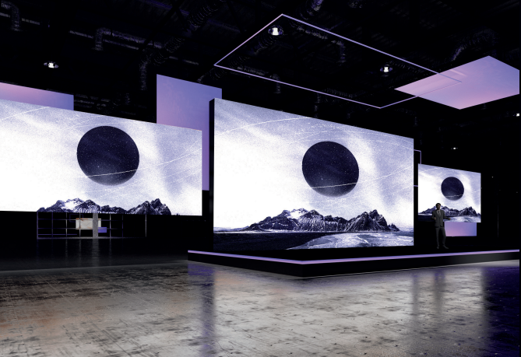

LED signage
Indoor
Outdoor
Indoor LED Signage delivers terrific picture quality and can be tailored-fit for the specific space requirements, giving customers a breathtaking experience.
Reliability, Visibility, Sustainability.
Ready to perform anywhere and all the time
Notes:
Я

Slide 23
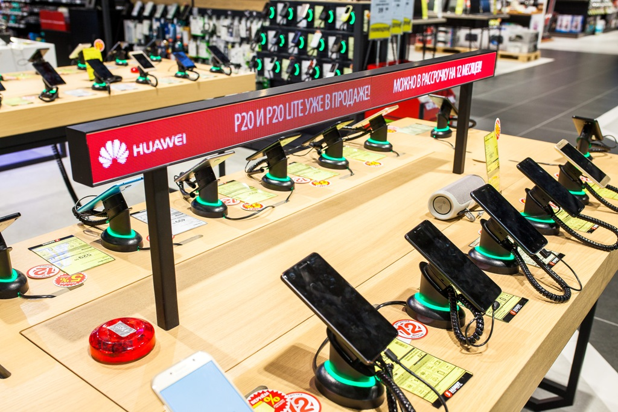
Prestigio Solutions™ IDS LED Shelf Signage | PDSIK2CA/PDSIK2CB
*Most popular model
Sales Uplift:
Drives product sales volume and cross-selling opportunities
Earn on selling advertising for suppliers in retail!
Operational Efficiency:
Optimize merchandising activities
Display Form Factor: | Modular
Display Type: | LED
Pixel Pitch PDSIK2CA/PDSIK2CB,mm: | 1.875
Pixel Density PDSIK2CA/PDSIK2CB: | 284 089 / 160 000 dots/m²
Image Brightness PDSIK2CA/PDSIK2CB: | 600 nit
Resolution Ratio PDSIK2CA/PDSIK2CB: | 160x32 / 320x32
Image Max. V-View Angle: | 160 °
Image Max. H-View Angle: | 160 °
Display Features: | High resolution: P1.875mm to display vivid image
 | Magnet, clip design for quick and easy installation
 | Tool free installation and disassembly
Input Voltage: | AC 100-240 V
Power Consumption Operational A/B: | 12 / 24 W/m²
Operating temperature | From -10 °C to 40 °C
DIMENSIONS A/B HxDxW, MM | 60x17.5x300 / 60x17.5x600
NET WEIGHT A/B, KG | 0.32 / 0.68
Production time Delivery time MOQ | 2 months 6 weeks (SEA delivery) 50 pcs per model (SKU)
Highlights advertising amongst the competitors
Plays video/static commercials
Increases brand awareness
220V-power supply and PC with Ethernet port 1000 BASE-T - are provided by customer.
The configuration of PC must be confirmed by both sides additionally.
Working with WINDOWS OS PC

Slide 24
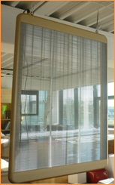
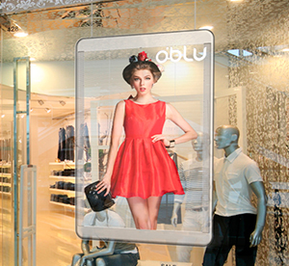
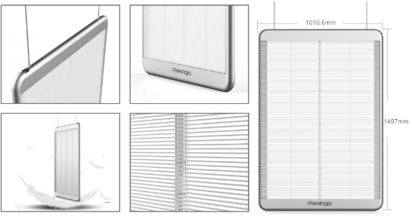
Transparent Poster (IDS LED Poster) | PDSWT63WNP
Display Form Factor: | Portrait Poster (H 5mm x V 8mm PP)
Display Type: | LED
Viewable Display Diagonal Length: | 63"
Display Size (HxW) mm | 1280x960
Whole resolution | 192 x 160
Resolution Density | 30720 dots
Image Max. V-View / H-View Angle: | 160 ° / 160 °
Brightness: | 6000 cd/m2
Display Features: | Patented side-lightning design with 4312 SMD LED High Transparency reaches 62% Lifetime 100 000h
Power Device Type: | Power Supply
Power Device Location: | Internal
Input Voltage: | AC 100-240 V
Input Frequency: | 50/60 Hz
Material: | Aluminum
Power Consumption Operational: | Max: 1050W / Avrg: 350W
DIMENSIONS (HxDxW), MM | 1497x50x1016,6
NET, KG | 21
RDP /RRP | $4760 USD/ $5869 USD
Production Time Delivery Time MOQ | 1.5 months 6 weeks (SEA delivery) 5 pcs
Unvarying brightness under direct sunlight
Plays video/static Ads
Improves Ads quality by innovative engaging approach
Sending Card , Receiving Card, IDS SW for the LED Poster settings – are included.

Slide 25
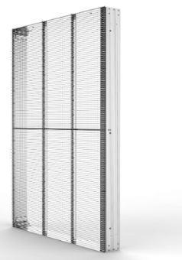

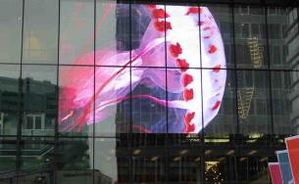
Prestigio Solutions™ IDS LED Transparent Video Wall (Indoor) | 10PP / 7.8PP / 3.91x7.81PP
System Type: | Digital Signage In-Window (Indoor)
System Form Factor: | Transparent
Display Form Factor: | Modular
Display Type: | LED
Display Technology: | SMD4312 (3 in 1)
Transparency | 60% - up to 76%
Pixel Pitch (V x H) 10/7.8/3.91x7.81: | 10x10PP / 7.8x7.8PP / 3.91x7.81PP
Resolution Density 10/7.8/3.91x7.81: | 10000 / 16384 / 32705 dots/m²
Image Brightness: | 5000 cd/m² (adjustable)
Image Max. V-View Angle: | 160 °
Image Max. H-View Angle: | 160 °
Display Features: | Transparent screen; Side-light technology; For large-scale glass wall; No cabinets, but modules only
Lifetime, h: | 100 000
Input Voltage: | AC 90-264 V
Input Frequency: | 50/60 Hz
Power Consumption Operational: | Avr: 300W/m²; Max: 800 W/m²
Operating Temperature: | From minus -10°C to +40 °C
Operating Humidity: | From 10% to 90%
Dimensions 10/7.8/3.91x7.81 | 2000x100x500 / 1000x100x1000 / 1300x100x500 In terms of dimensions – it’s customized LED VW
NET Weight (kg) 10/7.8/3.91x7.81 | 12 / 13 / 15 kg/m²
Pack Weight Brutto (kg) | TBC 18 / 20 / 25 kg/m² approx
Unvarying brightness under direct sunlight
Video/static content upload opportunities
Can be adjusted (enlarged/reduced) basing on the store windows dimensions
The total cost is a subject to a particular customer project
Production time: 2.5 months
Delivery time: train - 3 weeks / SEA – 6 weeks
MOQ: minimum order starting from 5m2
Sending Cards (Novastar controller), Receiving Cards (Novastar), IDS SW (Novastar) for the Video Wall settings – are included.

Slide 26
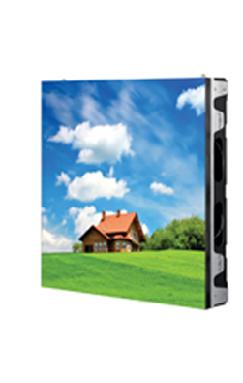
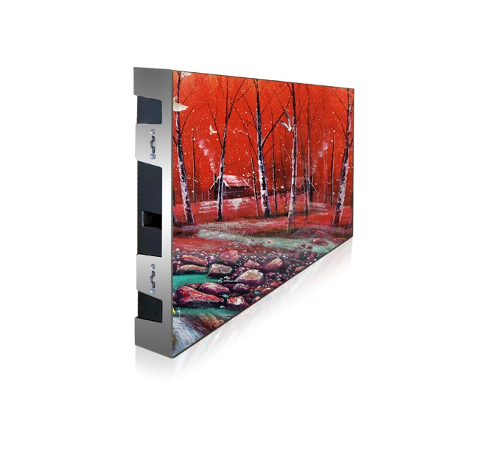
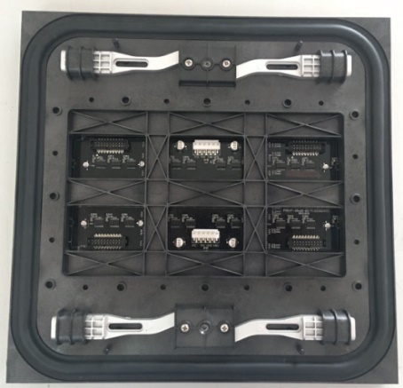
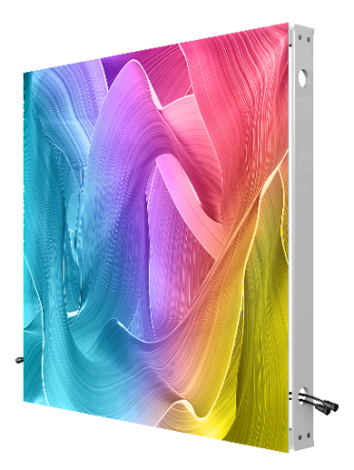
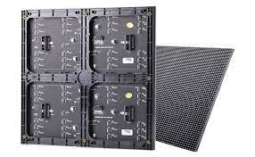
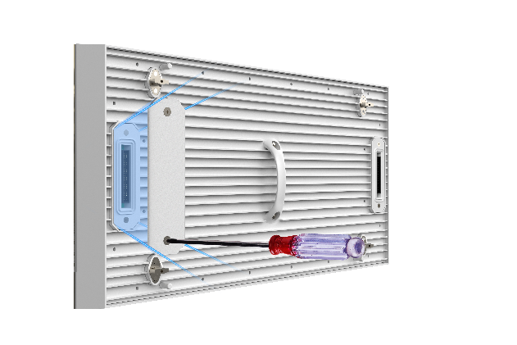

Prestigio Solutions™ IDS LED Non-Transparent Video Wall (Outdoor) | Front Service
Prestigio Solutions™ IDS LED Non-Transparent Video Wall (Indoor) | Front Service
Pixel Pitch: from 3mm to 20mm
IP Grade: IP65 front / IP54 rear
Brightness: >2000 cd/m2 up to ∞ (customizable)
Power Consumption Operational: Avg 200 – max 800 W/m²
Operating Temperature: From -40 °C to +50 °C
Operating Humidity: From 10% to 90%
Pixel Pitch: from 0.9mm to 8mm
IP Grade: IP44 front / IP44 rear
Brightness: >800 cd/m2 up to ∞ (customizable)
Power Consumption Operational: Avg 200 – max 600 W/m²
Operating Temperature: From -40 °C to +50 °C
Operating Humidity: From 10% to 90%
Video/static content upload opportunities
Included: LED Modules / LED Cabinets / Controller / LED Software
The total cost is a subject to a particular customer project, so please ask FOR A QUOTE
Production time: 2.5 months
Delivery time: train - 3 weeks / SEA – 6 weeks
MOQ: minimum order starting from 5$m^{2}$

Slide 27

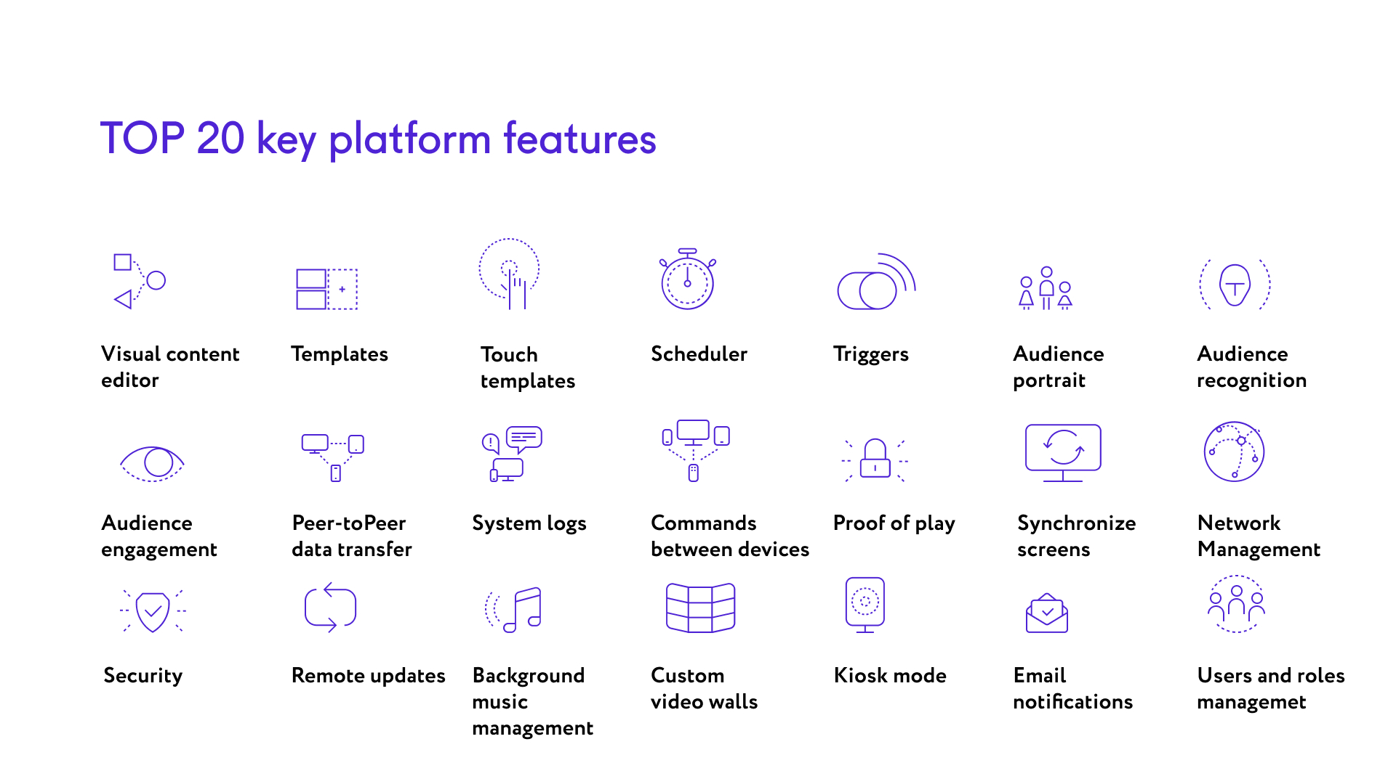
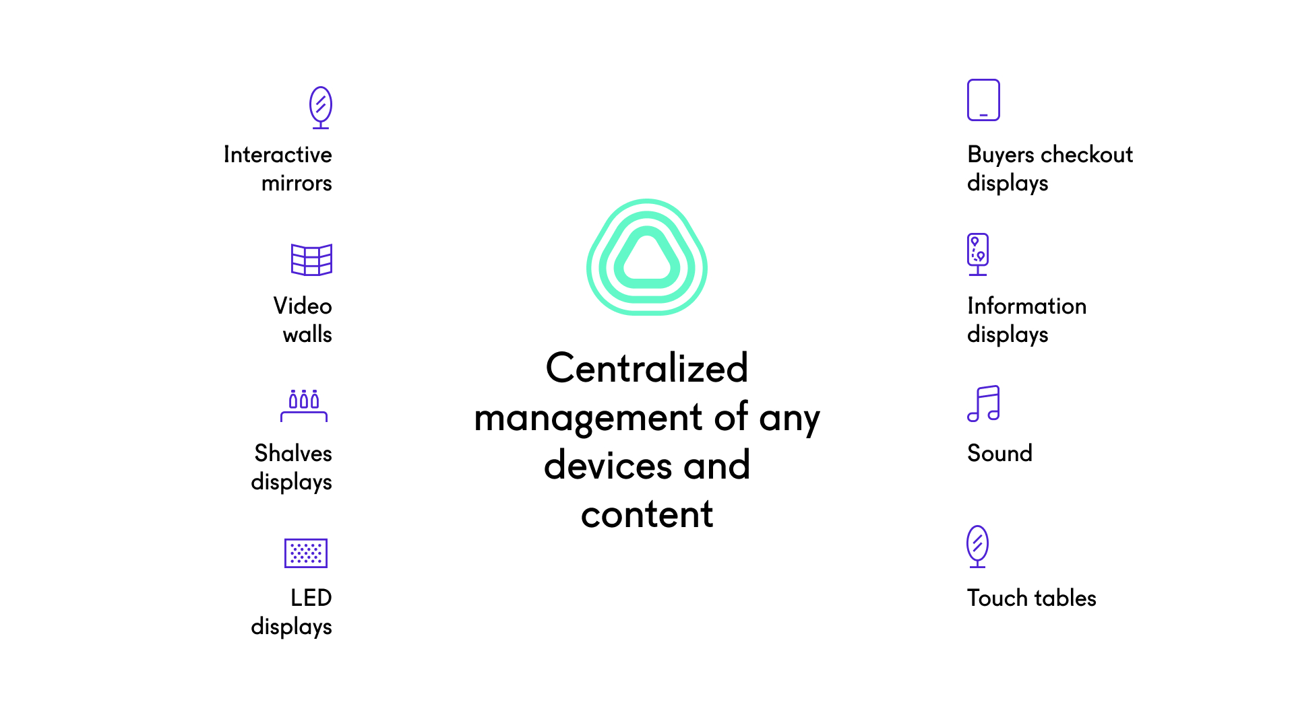
FOR
Comprehensive but simple all-in-one solution to link and manage your displays from anywhere. Create and deploy captivating content, gain powerful insights and flexibly manage and secure your hardware and software.
* licenses are obtaining at additional costs, except described cases

Slide 28


Slide 29

Prestigio IDS LED Shelf Signage | SPECIAL DEMO OFFER
IDS LED Shelf Signage | PDSIK2CA/PDSIK2CB
*SPECIAL SALES PRICE FOR DEMO:
PDSIK2CA (30cm): 70$ USD W/O VAT
PDSIK2CB (60cm): 90$ USD W/O VAT
Applicable for central & local stock
*Applicable for local stock as well.
Should be prior approved with Prestigio Solutions HQ
Photos & Video from Demo installation required

Slide 30

Prestigio Solutions™ Digital Signage Hand Sanitizer 21.5”
Wall Mount (stand included) PDSIM21CAN0P
*EOL
Vandal protection (metal case & 3mm tempered glass)
Integrated camera for targeting & content reaction
3L Auto hands dispenser
Remote administration, control and analysis (IDS SW)
Temperature sensor detection (50cm distance)
Switch ON/Off by schedule; End of liquid detection…
DIAGONAL SIZE, INCH / RATIO | 21.5” (3mm Tempered glass)
RESOLUTION | 1080:1920 FHD
BRIGHTNESS | 200 nit
COLOUR | 16.7M
Visual ANGLE | H178°/V178°
INTEGRATED PC | Android 7.1
CPU | Quad Core Cortex A 17
GPU | ARM Mali-T764
RAM | 4GB
ROM | 16GB
BUILD IN SPEAKERS | 2 x 5W
POWER CONSUPTION | 50W / standby 3W
POWER SUPPLY | AC100 – 240V 50/60Hz
ADDITIONALLY | 2MP front camera; WiFi (b,g,n); IDS SW 1Y FREE USAGE
PORTS | USB 2.0 x 2; LAN
UNIT DIMENSION (W*D*H), MM | 524 x 413 x 1900 mm
PACKAGE DIMENSION (W*D*H), MM | 1625 x 250 x 550 mm
NET / GROSS, KG | 27/ 35
LAST STOCK UNITS
Sales Price: 199$ USD w/o VAT
Applicable for central & local stock

Slide 31
Prestigio Solutions™ Digital Signage Wall Mount PRO 55” (PDSIK55WNN0U) *EOL
DIAGONAL SIZE, INCH / RATIO | 54.64” (55”) D-LED
RESOLUTION / R. FREQUENCY | 1920 x 1080 Landscape & Portrait usage / 60Hz
BRIGHTNESS | 350 cd/m2
COLOUR | 1.07B (8 bit)
VIEWING ANGLE | H178°/V178°
RESPONSE TIME | 6 ms
CONTRAST RATIO | 1000:1
LIFETIME / OPERATING MODE | 30 000 h min / 24/7
USB 2.0 | 1
HDMI CEC IN / VGA IN / Audio (IN/OUT) | 1/1/1
RS232 IN / RS232 OUT | 1/1 RJ45
UNIT DIMENSION (WXDXH), MM | 1243x70x714 mm / Bezel: 13.9 mm
PACKAGE DIMENSION (WXDXH), MM | 1364x154x824 mm
NET / GROSS, KG | 15 kg / 18.6 kg
HOUSING MATERIAL/COLOR | Metal / Black
OPERATING CONDITIONS | 0℃ to 40℃ / 20% to 85%
BUILD IN SPEAKERS | 5W*2
POWER CONSUMPTION | 140W / In standby: <0.5W
VESA | VESA size (400mm x 400mm)
ACCESSORY IN THE BOX | AC power cable, user guide, remote control, warranty card, Wall Mounting kit
POWER SUPPLY | 100V-240V, 50-60 Hz
Slim design
Metal case
Competitive price
Professional Panel 24/7
LAST STOCK UNITS
Sales Price: 333$ USD w/o VAT
Applicable for central & local stock

Slide 32

Special bundle

Slide 33

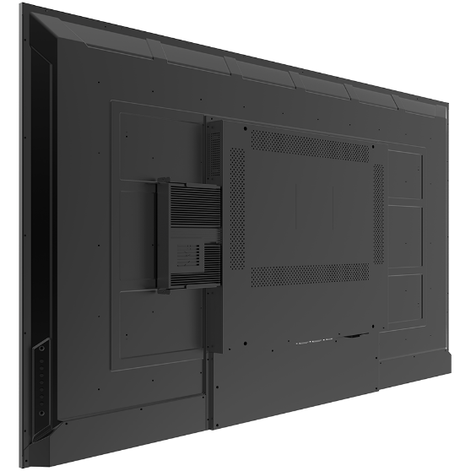
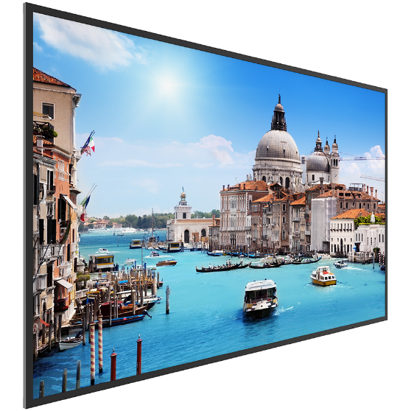
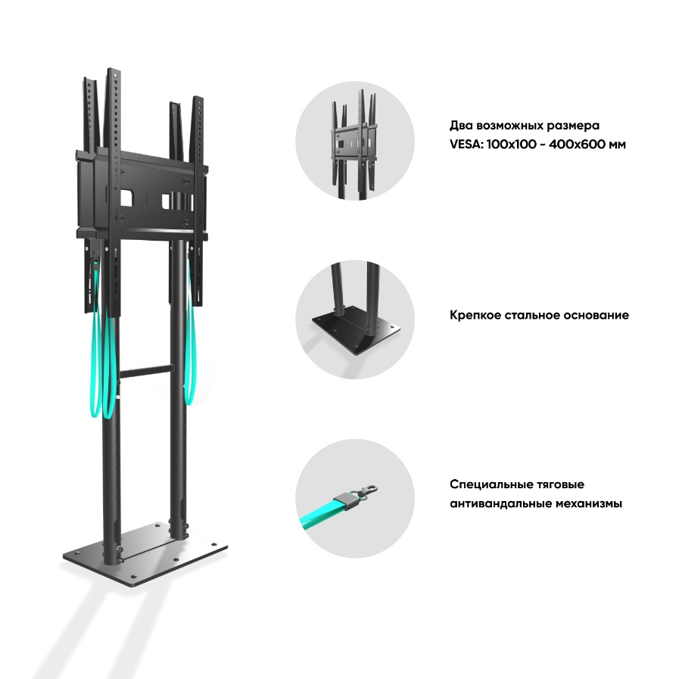
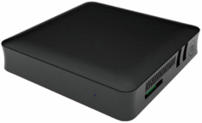
Architecture of Digital Signage displays and walls
FLOOR STAND DUAL DISPLAY
Why We Love It
Ideal for communicating with customers or info displays in public places
Back-to-back design allows for different information on each side of the stand
Securely manage equipment on a storage panel between the displays
Bring this portable solution just about anywhere
Portrait or Landscape
Remote control and device / content management
Camera Censor
Prestigio Solutions Commercial Displays
Digital Signage Box
Article | Description | Q-ty
PDSIK55WNN0L | Prestigio IDS LCD Wall Mount 55'' UHD 3840x2160 | 2
FSPRO2L-20 | ONKRON Stationary Dual TV Stand for 2 Screens Front and Back 40"-70" | 1
DFWRKA0B | Displayforce | 1
 | Digital Signage Box
PVCCF2M202 | WINDOWS HELLO CAMERA | 1
ONKRON fixed stand for two screens
Power Strip
*For RDP/RRP prices please check RoadMap accordingly
Thunderbolt
USB-C to HDMI
Cat6 HDBT
Cat6
Network + PoE
Network
Power
USB
HDMI

Slide 34


Thank you!

